Slide 1
CHAPTER 2
MODELING AS DESIGN TECHNIQUE

Slide 2
Abstraction:
The purpose of an abstraction is to limit the universe for the purpose of understanding.
In building models, therefore, it is needed to search for absolute truth but for adequacy for some purpose.
There is no single "correct" model of a situation, only adequate and inadequate ones.

Slide 3
A good model captures the crucial aspects of a problem and omits the others.
A model that contains extraneous detail unnecessarily limits the choice of design decisions and diverts attention from the real issues.

Slide 4
Modeling:
A model is an abstraction of something for the purpose of understanding it before building it.
Because a model omits nonessential details, it is easier to manipulate than the original entity.
Abstraction is a fundamental human capability that deals with complexity.

Slide 5
To build complex systems, the developer must abstract different views of the system, build models using precise notations, verify that the models satisfy the requirements of the system, and gradually add detail to transform the models into an implementation.
System Designers build many kinds of models for various purposes before constructing things.

Slide 6
E.g. Architectural models to show customers.
Airplane scale models for wind-tunnel tests.
Pencil sketches for composition of oil paintings.
Blueprints of machine parts
Storyboards of advertisements, and outlines of books.

Slide 7
Models serve several purposes:
Testing a physical entity before building it
Communication with customers
Visualization
Reduction of complexity

Slide 8
Testing a physical entity before building it:
Physical models can be simulated in computers.(ex: working of LAN) This simulation is cheaper and provides information that is too fleeting or inaccessible to be measured from a physical model.
Both physical models and computer models are usually cheaper than building a complete system and enable early correction of flaws.

Slide 9
Communication with customers:
Models are mock-ups to demonstrate to the customers a product/system by imitating some or all of the external behavior of a system.

Slide 10
Visualization:
Models visualize the flow of ideas thereby allowing for changes before implementing the system.

Slide 11
Reduction of complexity:
Perhaps the main reason for modeling, which incorporates all the previous reasons, is to deal with systems that are too complex to understand directly.
The human mind can cope with only a limited amount of information at one time.
Models reduce complexity by separating out a small number of important things to deal with at a time.

Slide 12
Three Models:
Each model describes a system from its own viewpoint.
Each model applies during all stages of development and acquires detail as development progresses.
A complete description of a system requires models from all three viewpoints.
The three models are separate parts of the description of a complete system but are cross-linked.

Slide 13
Three Models:
Class model
State model
Interaction model

Slide 14
Class model:
For the objects in the system and their relationships.
Goal in constructing a class model: To capture those concepts from the real world that are important to an application.

Slide 15
Describes the static structure of the objects in a system and their relationships; Represents the static, structural, "data" aspects of a system.
Describes the structure of objects in a system - their identity, their relationships to other objects, their attributes, and their operations.

Slide 16
Contains class diagrams: A class diagram is a graph whose nodes are classes and whose arcs are relationships among classes.
It expresses the class model. Generalization lets classes share structure and behavior, and associations relate the classes.
Classes define the attribute values carried by each object and the operations that each object performs or undergoes.

Slide 17
State model:
For the life history of objects;
It represents the temporal, behavioral, "control" aspects of a system.
Describes the aspects of an object that change over time and the sequencing of operations - events that mark changes, states that define the context for events, and the organization of events and states.

Slide 18
Specifies and implements control with state diagrams: A state diagram is a graph whose nodes are states and whose arcs are transitions between states caused by events.
State diagrams express the state model.
Each state diagram shows the state and event sequences permitted in a system for one class of objects.

Slide 19
State diagrams refer to the other models:
Actions and events in a state diagram become operations on objects in the class model.
References between state diagrams become interactions in the interaction model.

Slide 20
Interaction model:
For the interactions among objects.
Describes how the objects in a system cooperate to achieve broader results;
It represents the collaboration of individual objects, the "interaction" aspects of a system i.e. - how individual objects collaborate to achieve the behavior of the system as a whole.

Slide 21
The state and interaction models describe different aspects of behavior, and both the behavior need to be described fully.
Starts with use cases that are then elaborated with sequence and activity diagrams i.e. Use cases, sequence diagrams, and activity diagrams document the interaction model.

Slide 22
A use case focuses on the functionality of a system-that is, what a system does for users. They document major themes for interaction between the system and outside actors.
A sequence diagram shows the objects that interact and the time sequence of their interactions.
An activity diagram elaborates important processing steps. They show the flow of control among the processing steps of a computation.

Slide 23
Relationship Among the Models:
Each model describes one aspect of the system but contains references to the other models.
The class model describes data structure on which the state and interaction models operate. The operations in the class model correspond to events and actions.

Slide 24
o The state model describes the control structure of objects. It shows decisions that depend on object values and causes actions that change object values and state.
o The interaction model focuses on the exchanges between objects and provides a holistic overview of the operation of a system.

Slide 25
Class modeling
An OO system is built around objects rather than around functionality, because it corresponds to the real world more closely and is consequently more resilient with respect to change
Class models provide an intuitive graphic representation of a system and are valuable for communicating with customers.

Slide 26
Objects & Class concepts
Objects:
An object is a concept, abstraction, or thing with identity that has meaning for an application.
Often appear as proper nouns or specific references in problem descriptions and discussions with users.

Slide 27
The choice of objects depends on judgment and the nature of a problem; there can be many correct representations.
All objects have identity and are distinguishable.
The purpose of class modeling is to describe objects.
For example, Joe Smith, Simplex Company, process number 7648, and the top window are objects.

Slide 28
Class
An object is an instance or occurrence of a class.
A class describes a group of objects with the same properties (attributes), behavior (operations), kinds of relationships, and semantics.

Slide 29
Classes often appear as common nouns and noun phrases in problem descriptions and discussions with users.
Person, company, process, and window are all classes.
Each person has name and birth date and may work at a job.
Each process has an owner, priority, and list of required resources.

Slide 30
Class diagrams & object diagrams
Class diagrams provide a graphic notation for modeling classes and their relationships, thereby describing possible objects.
Object diagrams show individual objects and their relationships. Object diagrams are helpful for documenting test cases and discussing examples.

Slide 31
Figure shows a class (left) and instances (right) described by it.

Slide 32
UML symbol for :
Class:-a box. Class name is in boldface, center the name in the box, and capitalize the first letter. Singular nouns are used for the class names.
Object - a box with an object name followed by a colon and the class name. The object name and class name are both underlined. Object name and class name are listed in boldface. Objects with multiword names can be separated with words with intervening capital letters, such as JoeSmith,

Slide 33
Values and Attributes:
A value is a piece of data. Values can be found (for examples) by examining problem documentation.
An attribute is a named property of a class that describes a value held by each object of the class. They can be found by looking for adjectives or by abstracting typical values.
The following analogy holds: Object is to class as value is to attribute.

Slide 34
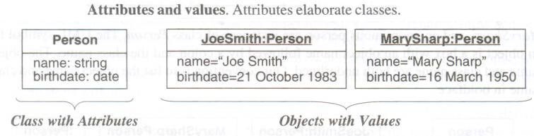
Modeling notation/UMLNotation

Slide 35
Class Name
Window
size: Size visibility: boolean
Attributes
display() hide()
Operations

Slide 36
Operations & methods
An operation is a function or procedure that may be applied to or by objects in a class.
Hire, fire, pay_Dividend are operations on class Company.
Open, close, hide, and redisplay are operations on class Window.
All objects in a class share the same operations.

Slide 37
A method is the implementation of an operation for a class.
For example, the class File may have an operation print. You could implement different methods to print ASCII files, print binary files, and print digitized picture files. All these methods logically perform the same task-printing a file; thus you may refer to them by the generic operation print. However, a different piece of code may implement each method.

Slide 38
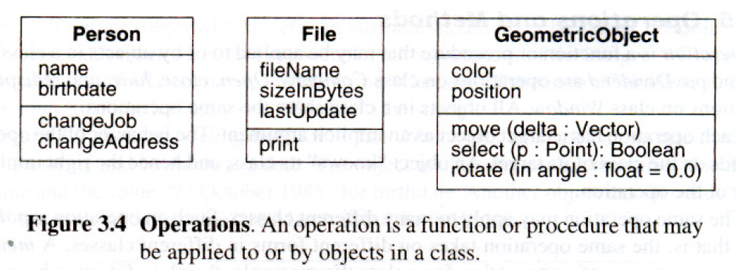

Slide 39
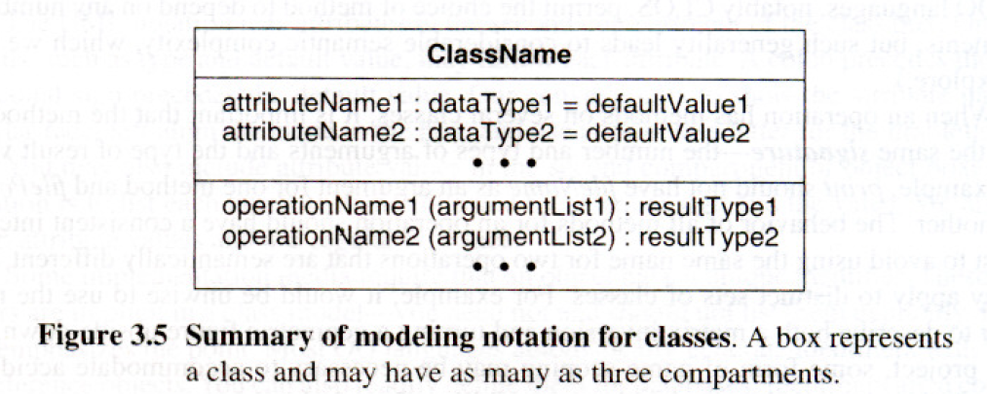
Summary of Notation for Classes

Slide 40
Link and Association Concepts
Links and associations are the means for establishing relationships among objects and classes.
A link is a physical or conceptual connection among objects. For example, Joe Smith Works-For Simplexcompany.
Most links relate two objects, but some links relate three or more objects.

Slide 41
An association is a description of a group of links with common structure and common semantics.
For example, a person WorksFor a company.
The links of an association connect objects from the same classes.
An association describes a set of potenti'al links in the same way that a class describes a set of potential objects.
Links and associations often appear as verbs in problem statements.

Slide 42
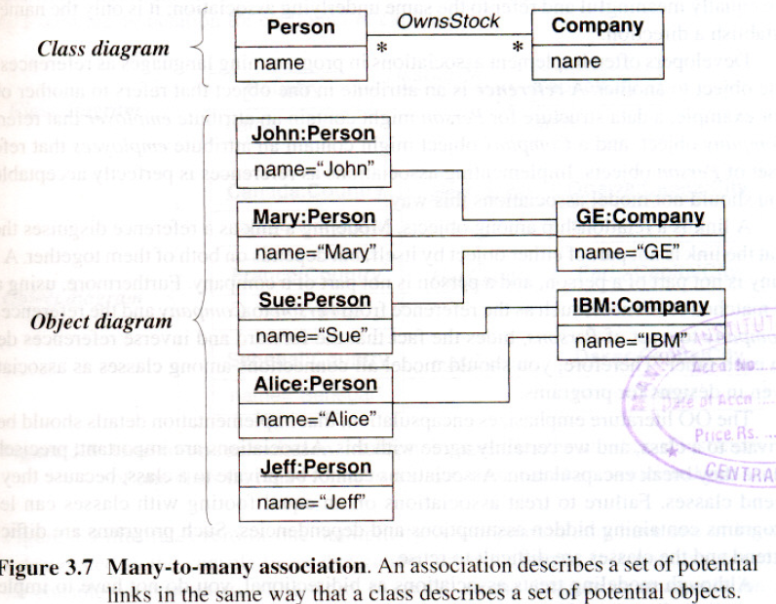

Slide 43
Multiplicity
Multiplicity specifies the number of instances of one class that may relate to a single instance of an associated class.
Multiplicity constrains the number of related objects.
UML diagrams explicitly list multiplicity at the ends of association lines.
The UML specifies multiplicity with an interval, such as "I" (exactly one), "1..*" (one or more), or "3..5" (three to five, inclusive).
The special symbol "*” is a shorthand notation that denotes "many" (zero or more).

Slide 44
Multiplicity indicators
Exactly one | 1
Zero or more (unlimited) | * (0..*)
One or more | 1..*
Zero or one (optional association) | 0..1
Specified range | 2..4
Multiple, disjoint ranges | 2, 4..6, 8

Slide 45
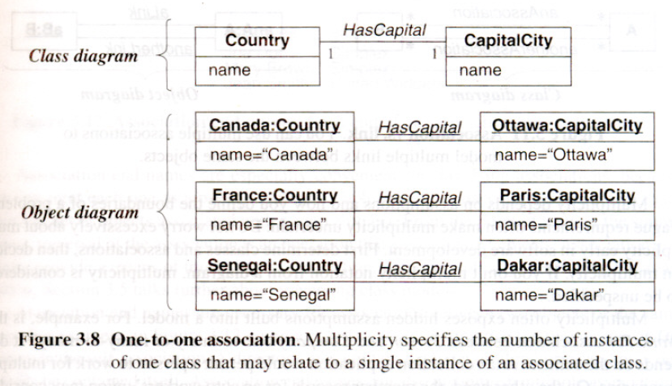

Slide 46
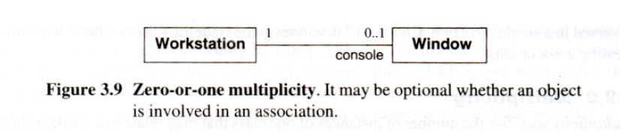
Figure above illustrates zero-or-one multiplicity.
A workstation may have one of its windows designated as the console to receive general error messages.
It is possible, however, that no console window exists. (The word "console" on the diagram is an association end Name)

Slide 47
Association end names
The notion of an association end is an important concept in the UML.
You can not only assign a multiplicity to an association end, but you can give it a name as well.
Association end names often appear as nouns in problem descriptions.
A person is an employee with respect to a company; a company is an employer with respect to a person.

Slide 48
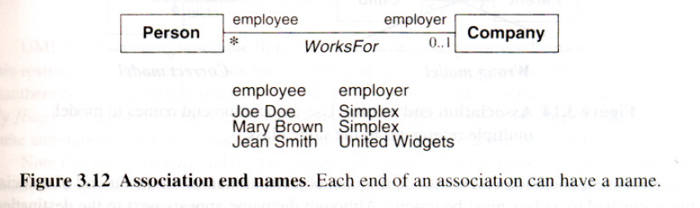

Slide 49
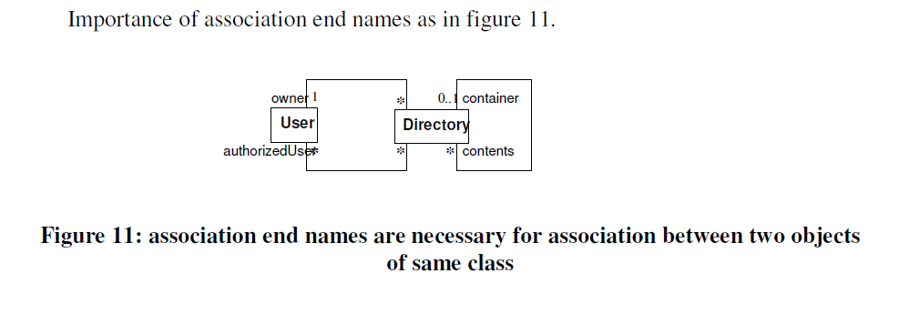

Slide 50
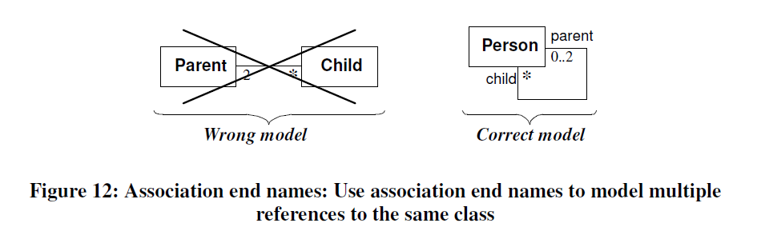

Slide 51
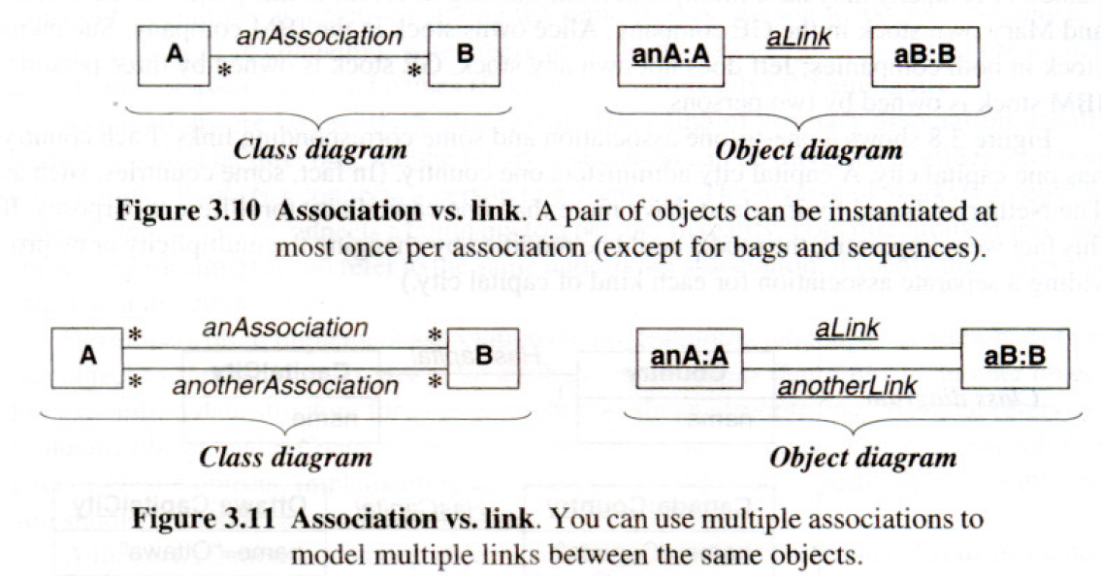

Slide 52
Do not confuse "multiplicity" with "cardinality.“
Multiplicity is a constraint on the size of a collection;
cardinality is the count of elements that are actually in a collection.
Therefore, multiplicity is a constraint on the cardinality.

Slide 53
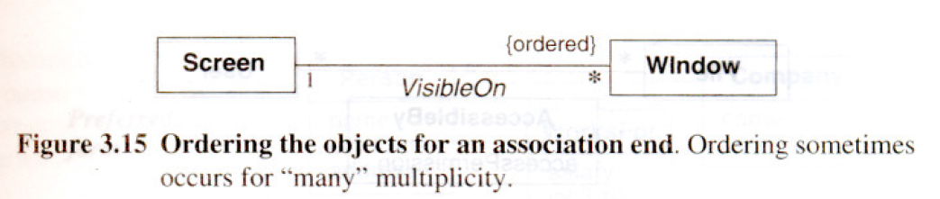
Ordering
workstation screen containing a number of overlapping windows. Each window on a screen occurs at most once.
The windows have an explicit order, so only the topmost window is visible at any point on the screen.

Slide 54
Bags & Sequences
A bag is a collection of elements with duplicates allowed.
A sequence is an ordered collection of elements with duplicates allowed.
Ex. an itinerary is a sequence of airports and the same airport can be visited more than once.
Like the {ordered} indication, {bag}and {sequence} are permitted only for binary associations.

Slide 55
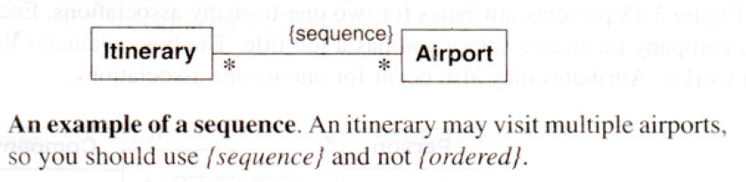

Slide 56
Association Classes
It is an association that is also a class.
Like the links of an association, the instances of an association class derive identity from instances of the constituent classes.
Like a class, an association class can have attributes and operations and participate in associations.
You can find association classes by looking for adverbs in a problem statement or by abstracting values.

Slide 57
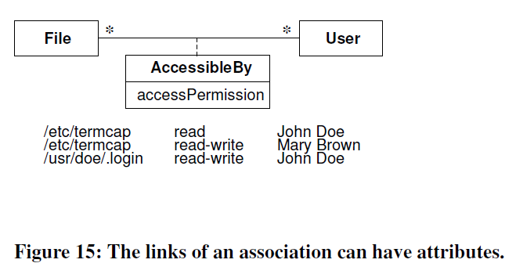

Slide 58
Many-to-many associations provide a compelling rationale for association classes.
Attributes for such associations unmistakably belong to the link and cannot be ascribed to either object.
In Figure 3.17, access Permission is a joint property of File and User and cannot be attached to either File or User alone without losing information.

Slide 59
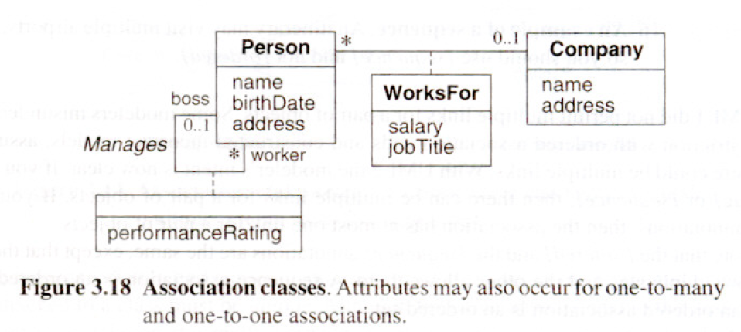

Slide 60
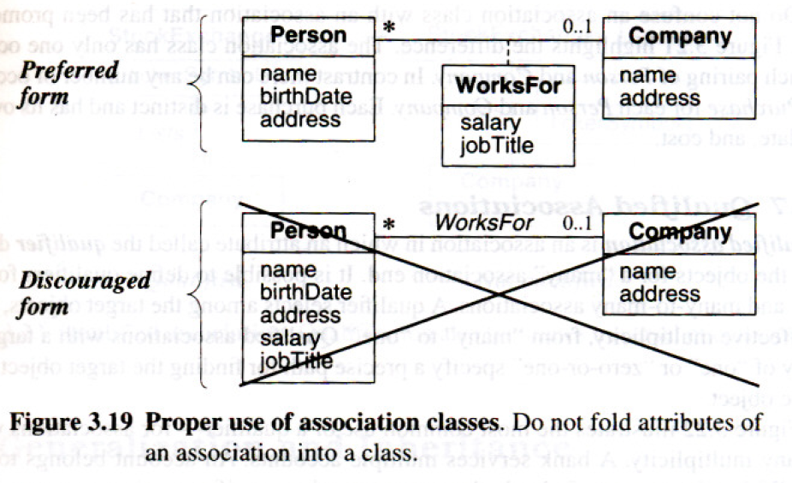

Slide 61
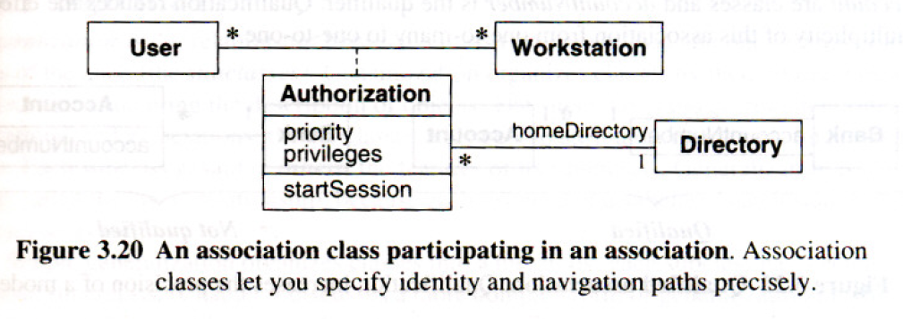

Slide 62
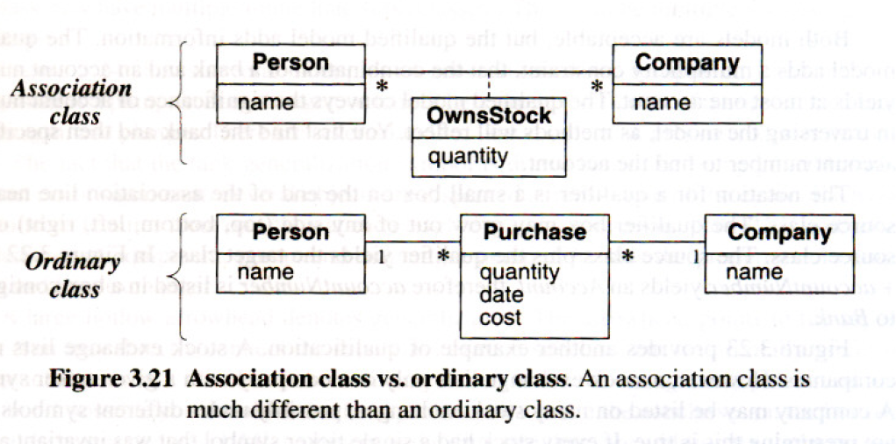

Slide 63
Do not confuse an association class with an association that has been promoted to a class.
Figure above highlights the difference. The association class has only one occurrence for each pairing of Person and Company.
In contrast there can be any number of occurrences of a Purchase for each Person and Company.
Each purchase is distinct and has its own quantity, date, and cost.

Slide 64
Qualified associations
A qualified association is an association in which an attribute called the qualifier disambiguates the objects for a "many" association end.
A qualifier selects among the target objects, reducing the effective multiplicity, from "many" to "one."

Slide 65
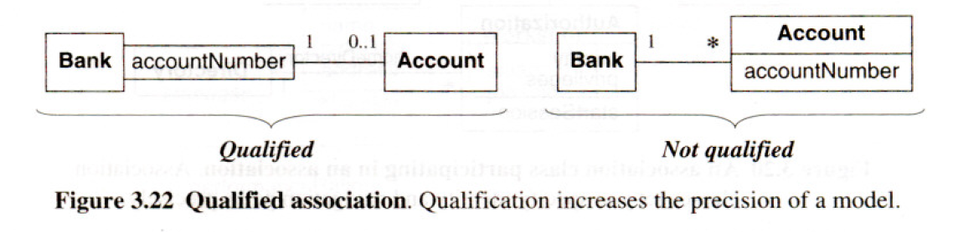

Slide 66
A bank services multiple accounts. An account belongs to a single bank.
Within the context of a bank, the account number specifies a unique account.
Bank and Account are classes and accountNumber is the qualifier.
Qualification reduces the effective multiplicity of this association from one-to-many to one-to-one.

Slide 67
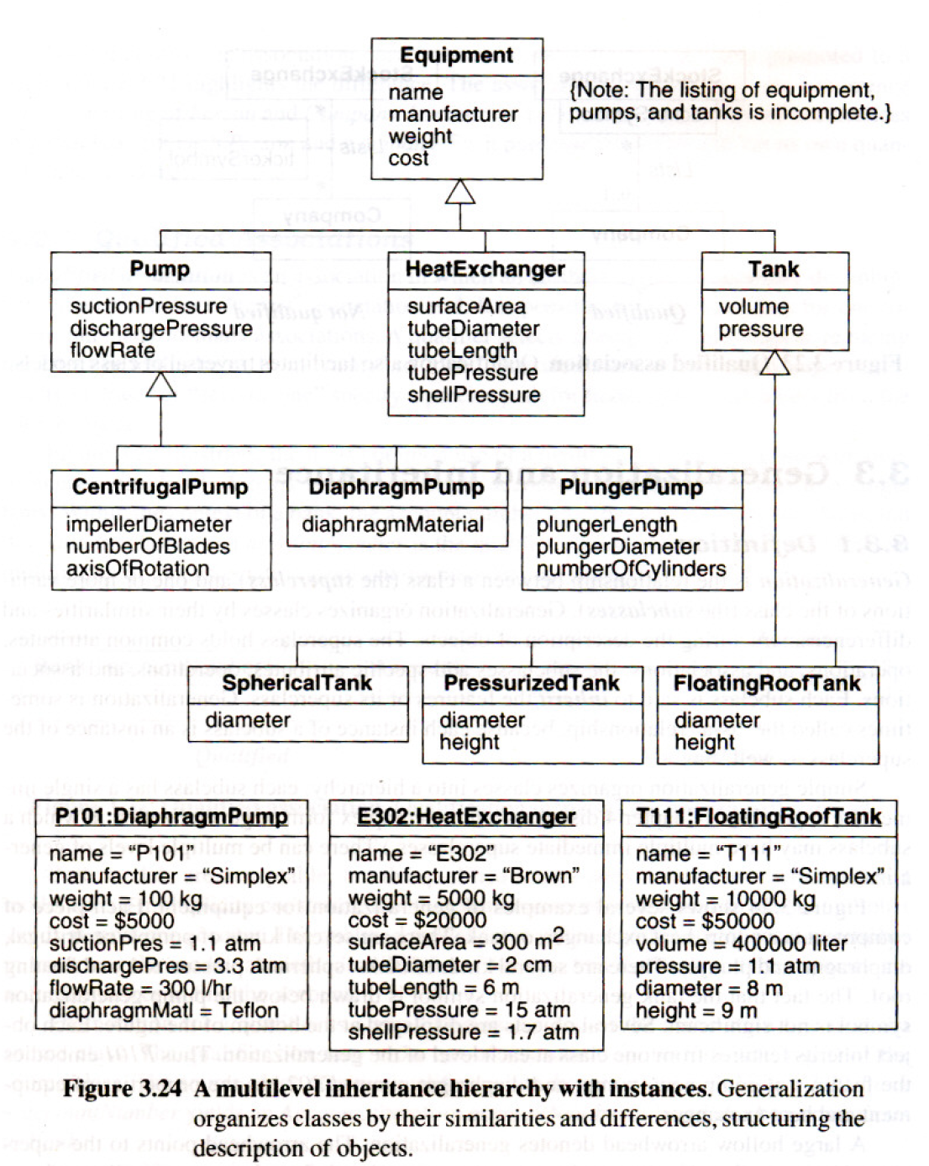
Generalization and Inheritance

Slide 68
Use of Generalization:
Serves three purposes:
Support for polymorphism.
Second purpose is to structure the description of objects.( a taxonomy is formed).
Third purpose is to enable reuse of code.

Slide 69
Generalization: derives from the fact that the superclass generalizes the subclasses.
Specialization: refers to the fact that the subclasses refine or specialize the Superclass.
Inheritance: is the mechanism for sharing attributes, operations, and associations via generalization / specialization relationship.

Slide 70
Overriding Features:
A subclass may override a superclass feature by defining a feature with the same name. The overriding feature (the subclass feature) refines and replaces the overridden feature (the superclass feature).
Reasons to prefer overriding a feature:
To specify behavior that depends on the subclass.
To tighten the specification of a feature, or
To improve performance.

Slide 71
Navigation of Class Models:
Class models not only express the structure of an application, but also the behavior of navigating among classes.
Navigation is important because it lets you exercise a model and uncover hidden flaws and omissions so that they can be repaired.
Navigation can be performed
Manually (an informal technique) or
By writing navigation expressions

Slide 72
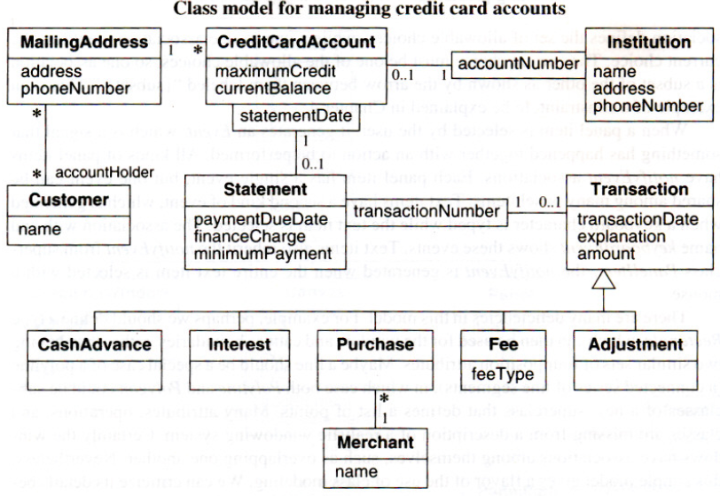
E.g. Class model for credit card accounts:
An institution may issue many credit card accounts, each identified by an account number. Each account has a maximum credit limit, a current balance, and a mailing address. The account serves one or more customers who reside at the mailing address. The institution periodically issues a statement for each account. The statement lists a payment due date, finance charge, and minimum payment. The statement itemizes various transactions that have occurred throughout the billing interval: cash advances, interest charges, purchases, fees, and adjustments to the account.
The name of the merchant is printed for each purchase.

Slide 73
A variety of questions can be posed against the model.
What transactions occurred for a credit card account within a time interval?
What volume of transactions was handled by an institution in the last year?
What customers patronized a merchant in the last year by any kind of credit card?
How many credit card accounts does a customer currently have?
What is the total maximum credit for a customer, for all accounts?

Slide 74
The UML incorporates a language that can express these kinds of questions - the Object Constraint Language (OCL).

Slide 75
OCL Constructs for Traversing Class Models:
The OCL can traverse the constructs in class models.
Attributes: It is possible to traverse from an object to an attribute value. The syntax is the source object, followed by a dot, and then the attribute name.
E.g. The expression aCreditCardAccount.maximumCredit
Similarly we can invoke an operation for an object. Syntax is the source object followed by a dot and then the operation
The OCL has special operations that operate on entire collections
The syntax for a collection operation is the source object collection, followed by "->", and then the operation.

Slide 76
Simple associations: A third use of the dot notation is to traverse an association to a target end( a class name).
Ex: aCustomer.MailingAddress
yields
a set of addresses for a customer (the target end has "many" multiplicity).
In contrast, aCreditCardAccount.MailingAddress
yields
a single address (the target end has multiplicity of one).

Slide 77
Qualified associations: A qualifier a more precise traversal.
The expression aCreditCardAccount.Statement[ 30 November 1999]
finds
the statement for a credit card account with the statement date of 30 November 1999.
The syntax is to enclose the qualifier value in brackets.
Alternatively, aCreditCardAccount.Statement
Finds
the multiple statements for a credit card account. (The multiplicity is "many" when the qualifier is not used.)

Slide 78
Filters: There is often a need to filter the objects in a set. The OCL has several kinds of filters, the most common of which is the select operation.
The select operation applies a predicate to each element in a collection and returns the elements that satisfy the predicate.
E.g. aStatement.Transaction -> select( amount>$100) finds the transactions for a statement in excess of $100.

Slide 79
OCL can be used to answer the credit card questions.
What transactions occurred for a credit card account within a time interval? ( hint : find the transactions within the time interval bounded by aStartDate and anEndDate)
aCreditCardAccount.Statement.Transaction->
select(aStartDate <= transactionDate and
transactionDate <= anEndDate)
The OCL select operator finds the transactions within the time intervals.

Slide 80
What volume of transactions was handled by an institution in the last year?
anlnstitution.CreditCardAccount.Statement.Transaction ->
select(aStartDate <= transactionDate and
transactionDate <= anEndDate) .amount -> sum()

Slide 81
What customers patronized a merchant in the last year by any kind of credit card?
aMerchant.Purchase->
select(aStartDate <= transactionDate and
transactionDate <= anEndDate) .Statement.
CreditCardAccount.MailingAddress.Customer->asSet()
The OCL asSet operator converts a bag of customers to a set of customers, resulting in required answer.

Slide 82
How many credit card accounts does a customer currently have?
aCustomer.MailingAddress.CreditCardAccount->size()

Slide 83
What is the total maximum credit for a customer, for all accounts?
aCustomer.MailingAddress.CreditCardAccount.
maximumCredit->sum()

